Slide 1

CSE 3121
Database Management Systems
Session: 2016-17
Dr. Asif Zaman
Associate Professor, CSE, RU
Week # 1

Slide 2
Syllabus
Chapter 2

Slide 3
Relational Model
The relational model is today the primary data model for commercial data processing applications.
It attained its primary position because of its simplicity, which eases the job of the programmer, compared to earlier data models.
A relational database consists of a collection of tables, each of which is assigned a unique name.

Slide 4
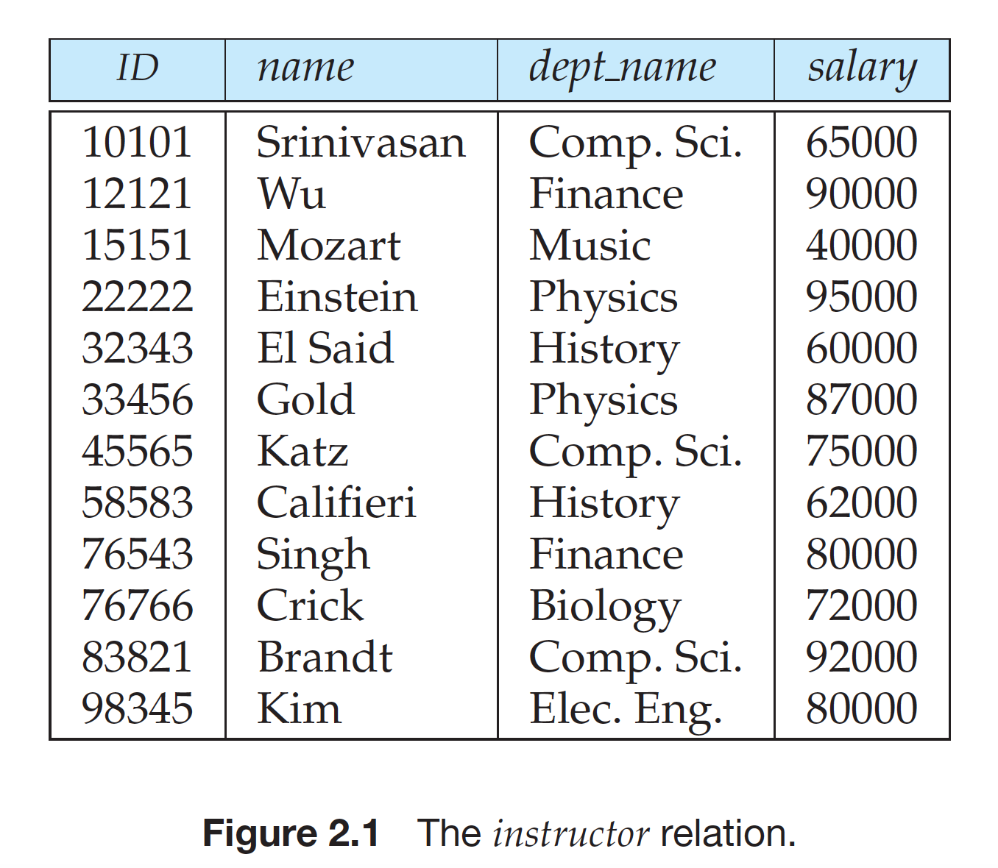
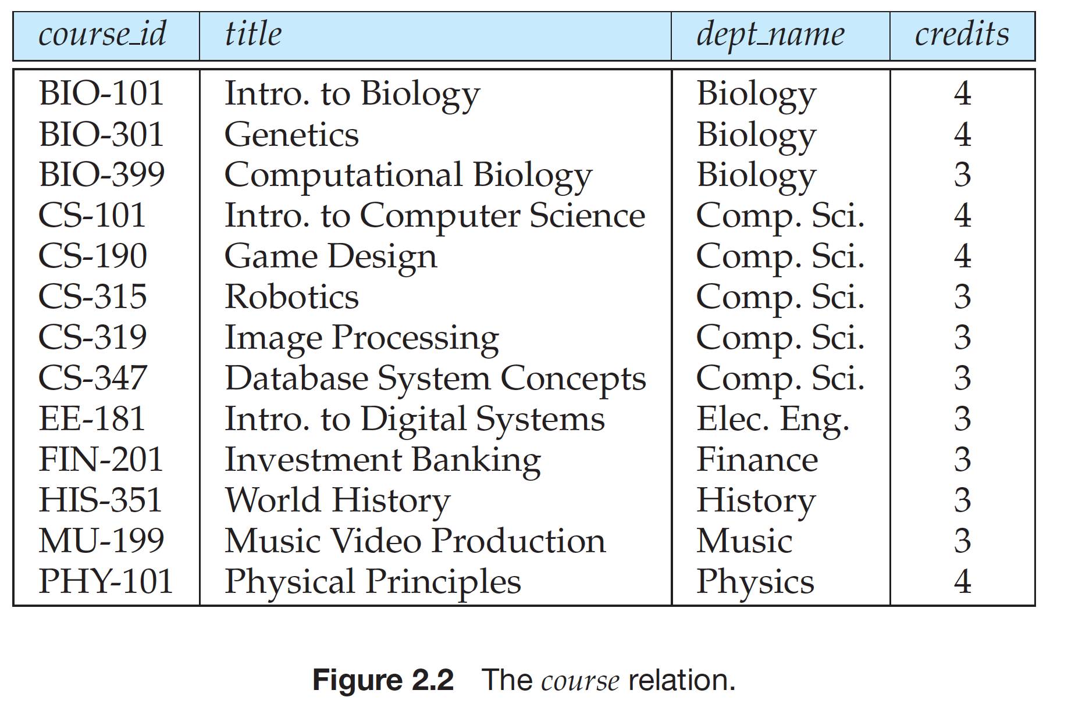
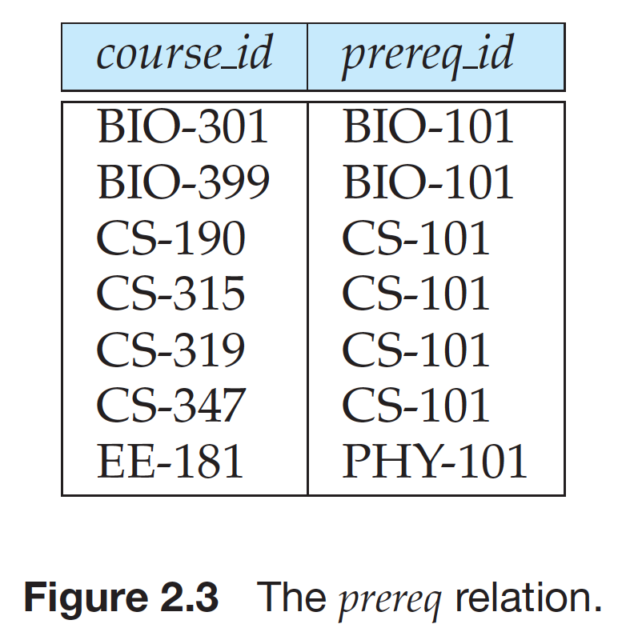
Relational Model
Each instructor is identified by the value of the column ID, while each course is identified by the value of the column course_id.
In the table instructor, a row … the relationship between a specified ID and the corresponding values for name, dept name, and salary values.
a row in the prereq table indicates that two courses are related in the sense that one course is a prerequisite for the other

Slide 5
Relational Model
Mathematical terminology, a tuple is simply a sequence (or list) of values.
A relationship between n values is represented mathematically by an n-tuple of values,
i.e., a tuple with n values, which corresponds to a row in a table.
Thus:
in the relational model the term relation is used to refer to a table,
the term tuple is used to refer to a row.
Similarly, the term attribute refers to a column of a table.

Slide 6
Relational Model
We use the term relation instance to refer to a specific instance of a relation,
i.e., containing a specific set of rows. The instance of instructor shown in Figure 2.1 has 12 tuples, corresponding to 12 instructors.

Slide 7
Relational Model
For each attribute of a relation, there is a set of permitted values, called the Domain of that attribute.
Thus, the domain of the salary attribute of the instructor relation is the set of all possible salary values, while the domain of the name attribute is the set of all possible instructor names.

Slide 8
Relational Model: Atomic Value
We require that, for all relations r, the domains of all attributes of r be atomic.
A domain is atomic if elements of the domain are considered to be indivisible units.
Phone_number
+8801611039966,
+8801711039966
+8801711039966

Slide 9
Relational Model: null
The null value is a special value that signifies that the value is unknown or does not exist.
For example, ….
We would then have to use the null value to signify that the value is unknown or does not exist.
… null values cause a number of difficulties when we access or update the database, and thus should be eliminated if at all possible.

Slide 10
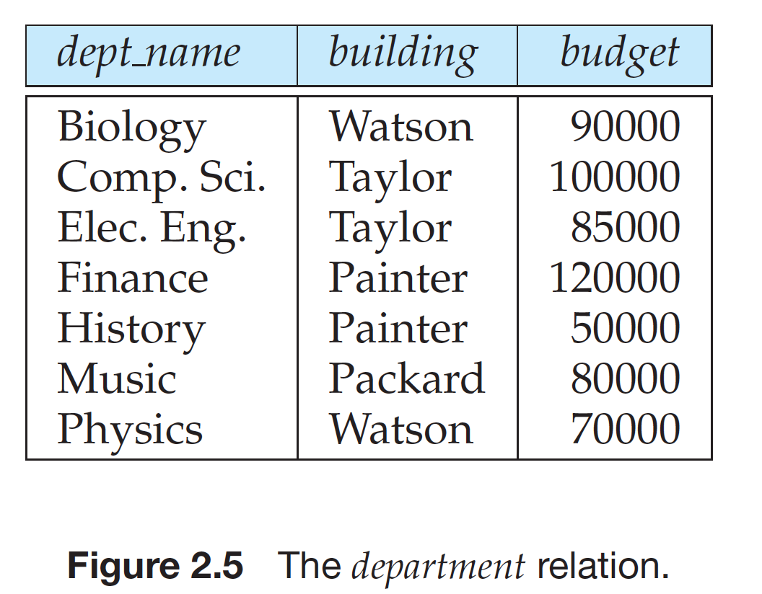
Relational Model
using common attributes in relation schemas is one way of relating tuples of distinct relations.

Slide 11
Relational Model: keys
We must have a way to specify how tuples within a given relation are distinguished.
This is expressed in terms of their attributes.
That is, the values of the attribute values of a tuple must be such that they can uniquely identify the tuple.
In other words, no two tuples in a relation are allowed to have exactly the same value for all attributes

Slide 12
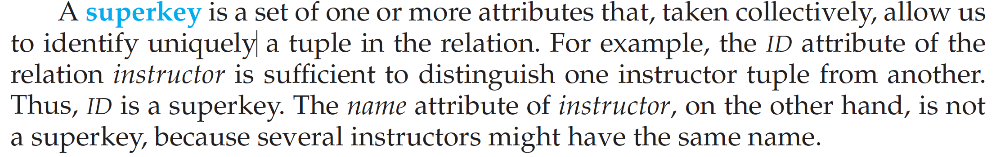
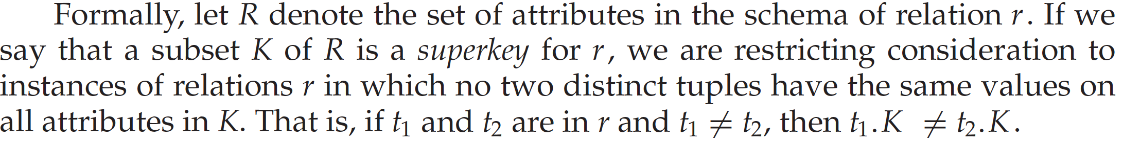
Relational Model: Superkey

Slide 13
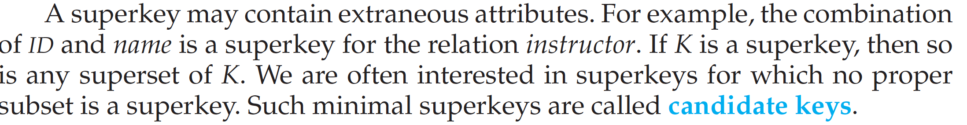
Relational Model: Candidate keys
It is possible that several distinct sets of attributes could serve as a candidate key.
Suppose that a combination of name and dept_name is sufficient to distinguish among members of the instructor relation.
Then, both {ID} and {name, dept name} are super keys.
Although the attributes ID and name together can distinguish instructor tuples, their combination, {ID, name}, does not form a candidate key, since the attribute ID alone is a candidate key.

Slide 14
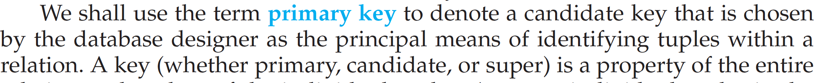
Relational Model: Primary Key

Slide 15
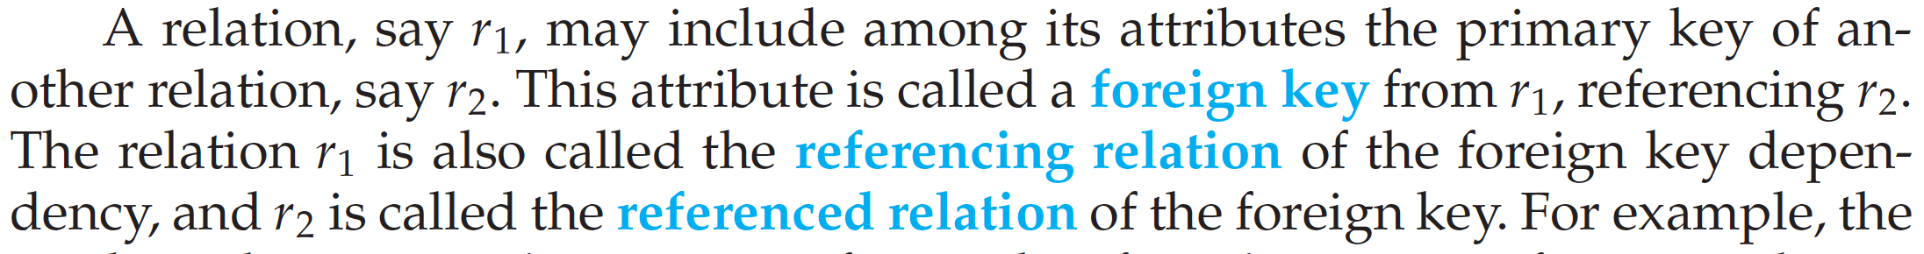
Relational Model: Foreign Key
Foreign Key Constraints

Slide 16
referential integrity constraint
id
id
id

Slide 17
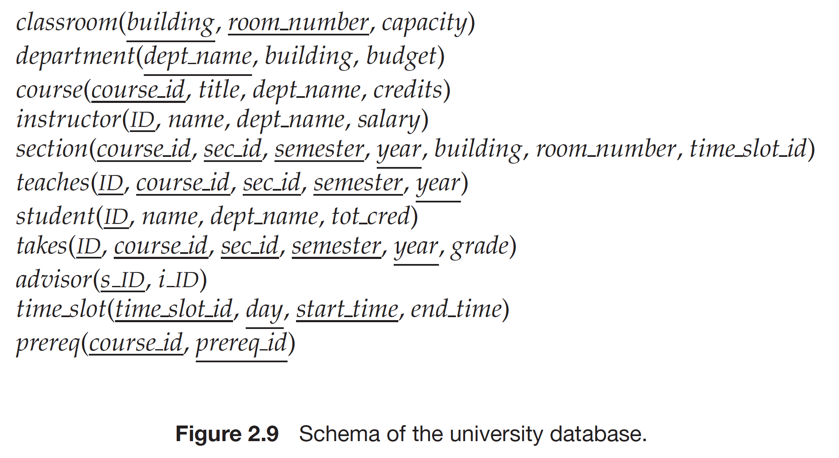
Schema Diagrams
A database schema, along with primary key and foreign key dependencies, can
be depicted by schema diagrams.

Slide 18
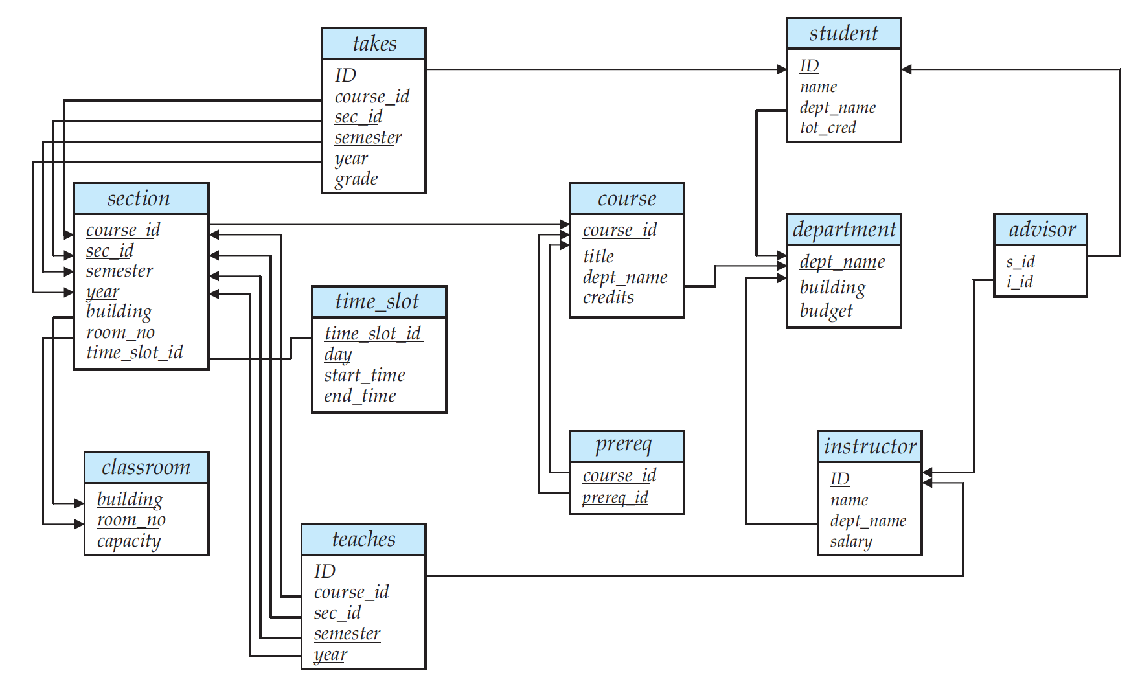
Schema Diagrams

Slide 19
Relational Query Languages
Procedural versus non-procedural, or declarative
“Pure” languages:
Relational algebra
Tuple relational calculus
Domain relational calculus

Slide 20
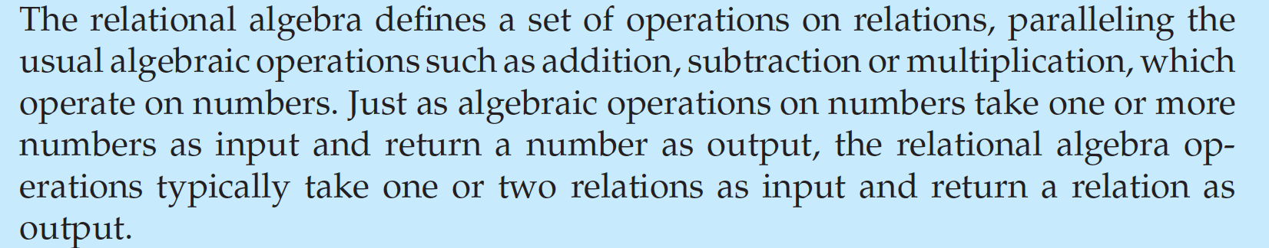
Relational Algebra
Six basic operators
select: σ
project: ∏
union: ∪
set difference: –
Cartesian product: x
rename: ρ

Slide 21
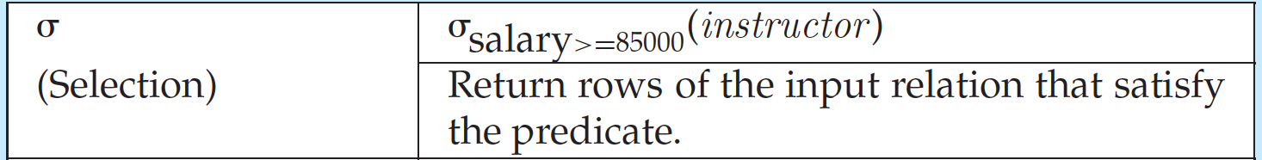
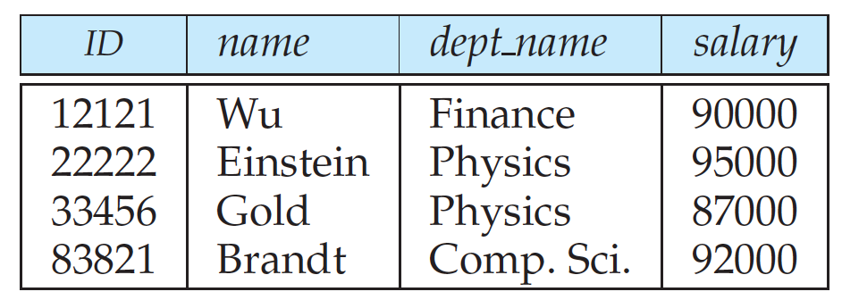
Select Operation

Slide 22
Select Operation (Cont.)
We allow comparisons using
=, ≠, >, ≥. <. ≤
in the selection predicate.
We can combine several predicates into a larger predicate by using the connectives:
∧ (and), ∨ (or), ¬ (not)
Example: Find the instructors in Physics with a salary greater $90,000, we write:
σ _{dept_name=“Physics”} ∧ _{salary>90,000} (instructor)
Then select predicate may include comparisons between two attributes.
Example, find all departments whose name is the same as their building name:
σ _{dept_name=building} (department)

Slide 23
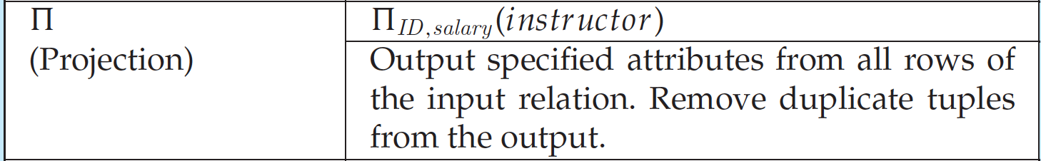
Project Operation

Slide 24
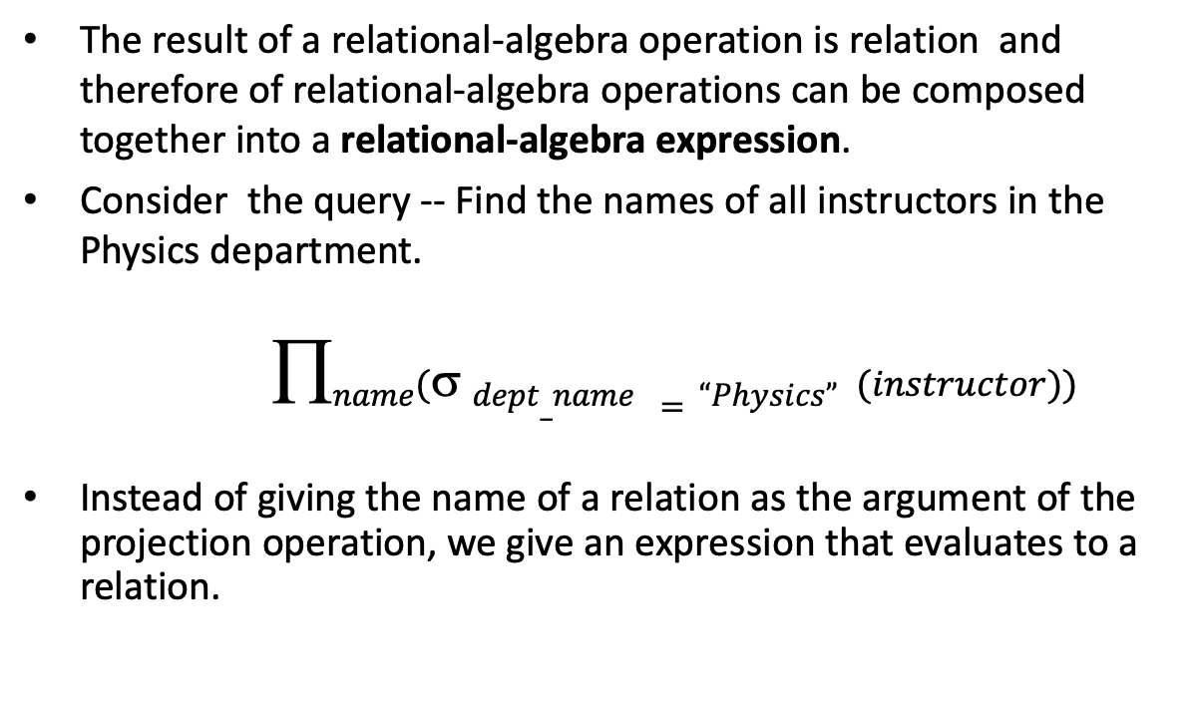
Composition of Relational Operations
The result of a relational-algebra operation is relation and therefore of relational-algebra operations can be composed together into a relational-algebra expression.
Consider the query -- Find the names of all instructors in the Physics department.
$$name( dept_name =“Physics” (instructor))$$
Instead of giving the name of a relation as the argument of the projection operation, we give an expression that evaluates to a relation.

Slide 25
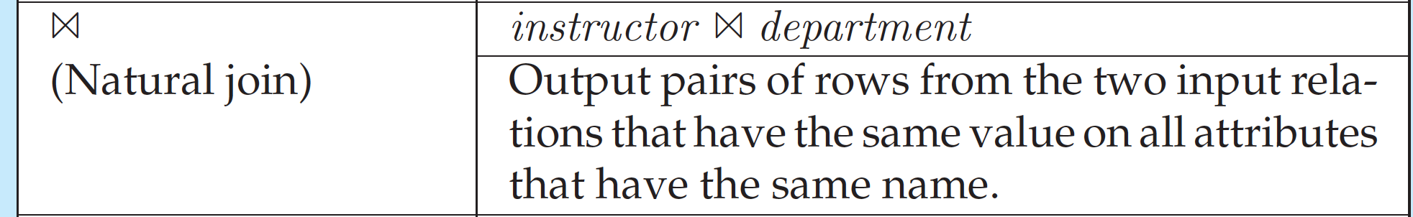
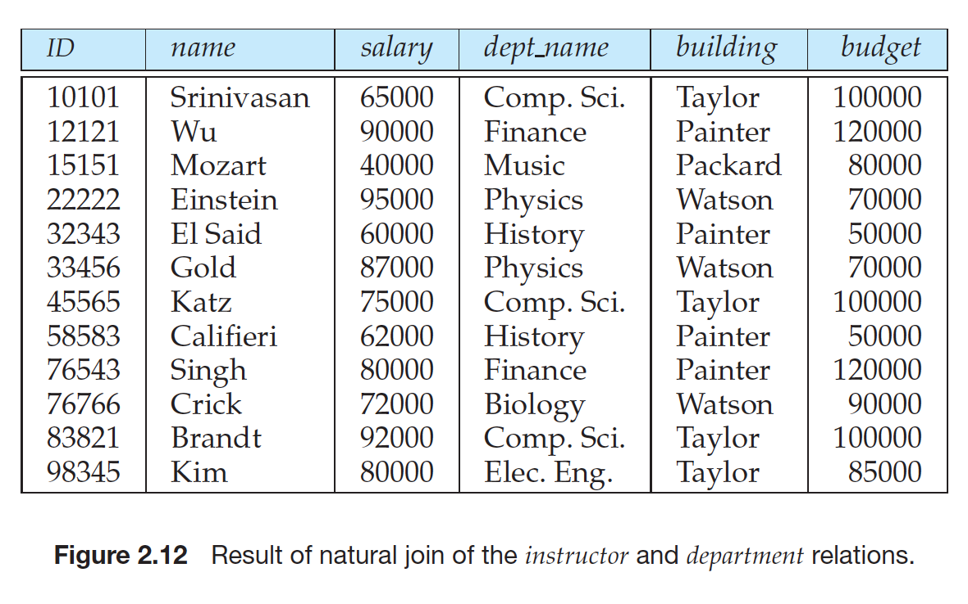
Natural Join

Slide 26
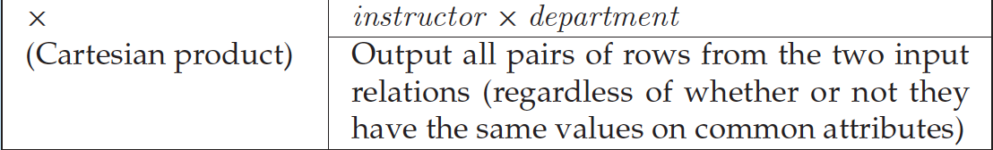
Cartesian Product

Slide 27
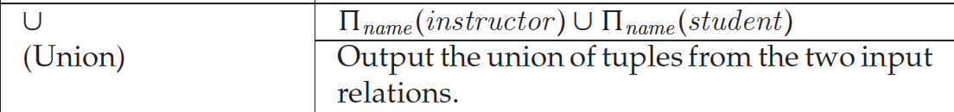
Union Operation

Slide 28
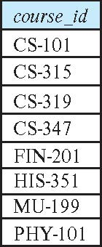
Union Operation (Cont.)
Result of: ∏_{course_id} (σ _{semester=“Fall” Λ year=2017} (section)) ∪ ∏_{course_id} (σ _{semester=“Spring” Λ year=2018} (section))

